Slide 1







PROJECTS | PRODUCTS | COURSE | INTERNSHIP
info@discoverprojects.com
www.discoverprojects.com
pro.aiskool@gmail.com
www.aiskool.com
Shop no. 2, Narayan Smurti Building, Opp. Saraswati Book Depot,
Near CIDCO Bus Stop, Thane West, India.
+91 9967478289 / +91 9167769993

Slide 2

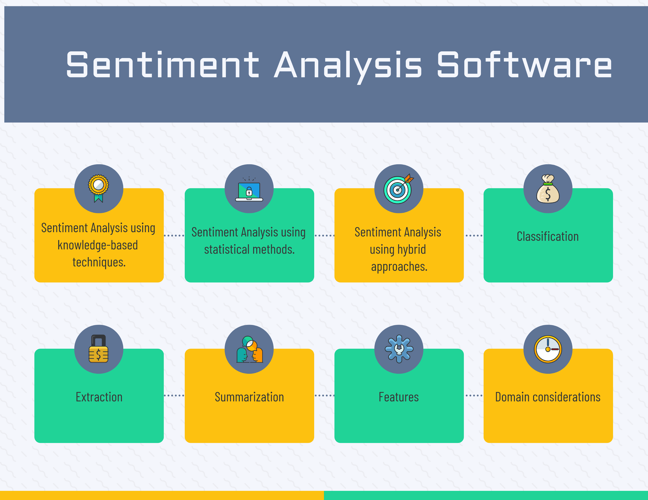
Sentiment Analysis
Relevant Image

Slide 3
Introduction and Application
The objective is to build a machine for sentiment analysis using CNN.

Slide 4
Working
FIRST STEP WAS TO COLLECT DATA FROM DIFFERENT SOURCES FOR OUR PROBLEM STATEMENT .
THEN WE HAVE TO CLEAN , PROCESS CATEGORICAL DATA AND NORMALISE IT.
THEN WE SHOW VARIOUS ANALYSIS USING GRAPHS.
SPLIT THE DATA INTO TRAINING AND TEST SET.
SELECT AN ALGORITHM.
FITTING THE MODEL TO TRAINING SET.
SAVING THE MODEL
CHECK ACCURACY OF TRAINED DATA W.R.T TRAIN SET.
TEST THE TRAINED MODEL W.R.T TESTING SET.
CHECK ACCURACY OF TEST DATA W.R.T TEST SET.
BASED ON THE GENERATED GRAPHS WE CAN ANALYSE.

Slide 5
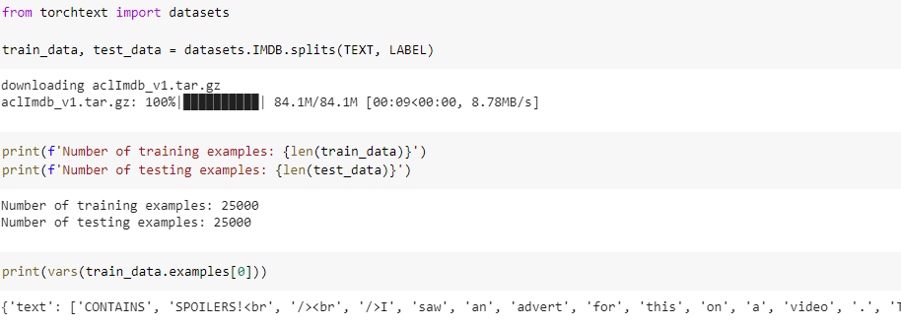
Working and Building
This is the data that we are using for the sentiment analysis. The source for dataset is torchtext.dataset.

Slide 6
Selecting Algorithm
A Convolutional Neural Network (ConvNet/CNN) is a Deep Learning algorithm which can take in an input image, assign importance (learnable weights and biases) to various aspects/objects in the image and be able to differentiate one from the other.

Slide 7
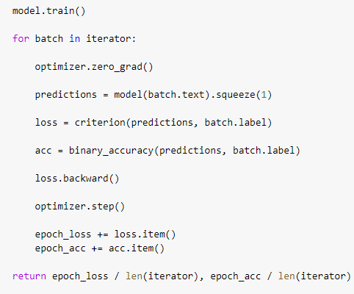
Predictions

Slide 8
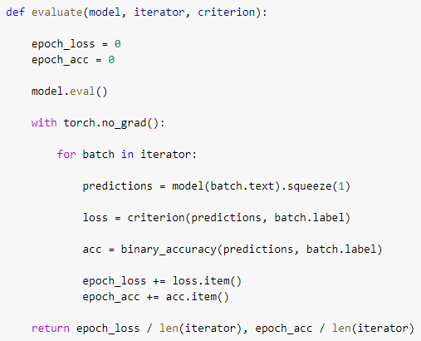
Evaluate, Tune and Improve Neural Network

Slide 9
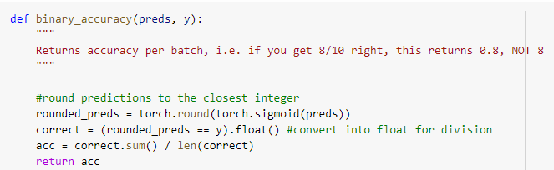
Calculating Efficiency:
We have created a function for calculating binary accuracy.

Slide 10
FAQ
What is the use of read_csv()?
read_csv() is an important pandas function to read csv files and do operations on it.
2. Is CNN better than RNN?
RNN is suitable for temporal data, also called sequential data. CNN is considered to be more powerful than RNN. RNN includes less feature compatibility when compared to CNN. This network takes fixed size inputs and generates fixed size outputs.

